Slide 1
Highway Planning & Design Lecture - 6
Designed and presented
By
Asst. Prof. Dr. Raquim Nihad Zehawi

Slide 2
Length of Sag Vertical Curves
The minimum length of a sag vertical curve is controlled by:
SSD provided by the headlight,
comfort while driving on the curve,
general appearance of the curve, and
adequate control of drainage at the low point of the curve.

Slide 3
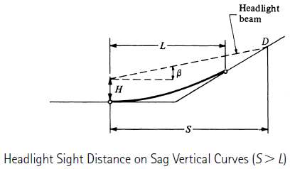
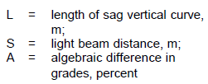
SSD provided by the headlight
Minimum Length based on SSD Criterion:
The headlight SSD requirement is based on the fact that sight distance will be restricted during periods of darkness

Slide 4
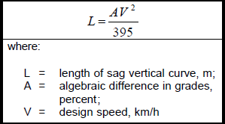
Minimum Length based on Comfort Criterion
when a vehicle travels on a sag vertical curve, both the gravitational and centrifugal forces act in combination, resulting in a greater effect than on a crest vertical curve where these forces act in opposition to each other
Radial acceleration is not greater than 0.3 m/s2 or 1 ft /sec2
L (comfort) is about 75 percent of that of headlight SSD

Slide 5
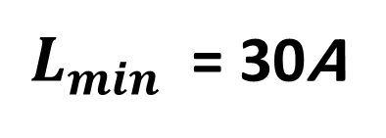
Minimum Length of Curve based on Appearance Criterion
the minimum length of the sag curve is not less than expressed by the following equation:
$L_{min}$ = 30A
Minimum Length based on Drainage Criterion
must be considered when the road is curbed
there is a maximum length requirement rather than a minimum length
a minimum slope of 0.35 percent be provided within 50 ft of the lowest point of the curve

Slide 6
Example 6
Minimum Length of a Sag Vertical Curve
A sag vertical curve is to be designed to join a -5% grade to a +2% grade. If the design speed is 70 Km/h, determine the minimum length of the curve that will satisfy all criteria. Assume a =3.4m/s2 and perception-reaction time 2.5 sec.
Solution:
1- Determine the SSD
$$s=0.28.V.t+\frac{V^{2}}{254((\frac{a}{g})±G)}$$
$$S=0.28×2.5 ×70+\frac{({70)}^{2}}{254(\left(\frac{3.4}{9.81}\right)−0.05)}$$
$$S=114 m$$
2- Determine whether S < L or S > L for the headlight sight distance criterion
$$L=2×114−\frac{120+3.5×114}{ \left| −5−2\right|}=135 m$$
if S > L
$$L=\frac{7×({114)}^{2}}{120+3.5×114}=175 m$$
Since S < L , then

Slide 7
3- Determine the length of the curve depending on K value
From Table, K = 17 for Design Speed of 70 Km/h
$$L=K.A=17×7=119 m$$
4- Determine minimum length for the comfort criterion.
$$L=\frac{A.V^{2}}{395}=\frac{7×{70}^{2}}{395}=86.8 m$$
5- Determine minimum length for the general appearance criterion
$$K=30$$
$$L=30A$$
$$L=30×7=210 m$$

Slide 8
Example
A sag vertical 22 stations long curve where a grade of -3% leads into the curve and a +2% grade follows the curve, the elevation of PVI = 134’. There is a bridge located 150’ following the PVI with a clearance of 12’ under its bottom whose an elevation of 160’.
It is required to increase the clearance to be 14’ to allow bigger trucks to pass under the bridge. Determine the length of the new curve.
Solution:
The new curve should be shorter than the existing one “having the same midpoint
The available information is for a point under the bridge whose
elevation 160 – 14 = 146’ and horizontal distance x = L/2 + 150
Solving the general equation in terms of L
$y_{x}=\left(\frac{G_{2}−G_{1}}{2L}\right)x^{2}+G_{1}x+Elevation at PVC$
$$E_{PVC}=135+0.03×\frac{L}{2}$$
$Elevation at PVC$ in terms of L
$146=\left(\frac{0.02+0.03}{2L}\right){(\frac{L}{2}+150)}^{2}−0.03 (\frac{L}{2}+150)+(135+0.03×\frac{L}{2})$

Slide 9
$146=\left(\frac{0.02+0.03}{2L}\right){(\frac{L}{2}+150)}^{2}−0.03 (\frac{L}{2}+150)+(135+0.03×\frac{L}{2})$
$146=\left(\frac{0.025}{L}\right){(\frac{L^{2}}{4}+150L+22500)}^{}−0.015L−4.5+135+0.015L$
$146+4.5−135=\left(\frac{0.025}{L}\right){(\frac{L^{2}}{4}+150L+22500)}^{}$
$\frac{15.5L}{0.025}={0.25L^{2}+150L+22500}^{}$
$$0={0.25L^{2}−470L+22500}^{}$$
$$L={1830}^{′}$$

